Slide 1

Babak Emami,
Emami.Babak@gmail.com
647-326-6199

Slide 2

Scotia Bank Predictor Model :
Create a recommender system to predict class label
Download Link: https://github.com/BabakEA/predictor-Model

Slide 3

Scotia_Bank.R
Installing the python libraries
install.packages(c('lattice','ggplot2','randomForest','caret', 'ROSE’)
Call the library :
library(dplyr)
library(lattice)
library(randomForest)
library(ggplot2)
library(caret)
library(ROSE)

Slide 4
Objectives
Data Normalization :
Noise reduction: To reduce the complexity of the Model
Data Balancing :Use the balancing technique to produce relevant models and data results
Create the model:
Use Random Forest
Test the model on test data:
Future Work

Slide 5

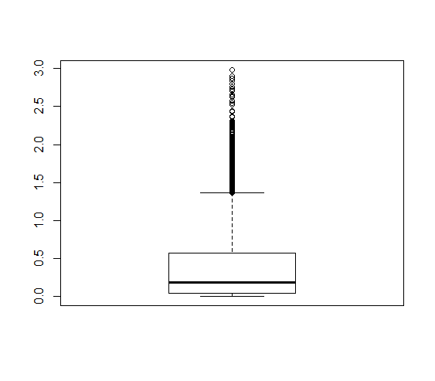
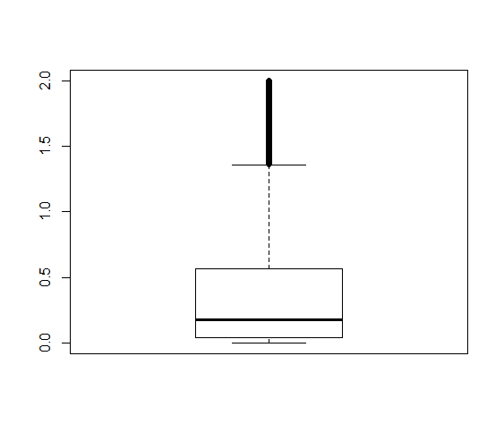
Data Normalization :
Scaling: Data columns must be normalized to increase the linearity of the model or increase the accuracy of prediction. To address this issue, the MonthlyIncome will be replaced by Log (MonthlyIncome,10) and, age has replaced by (age/10)
Following Code, shows the scaling step on this project
train$MonthlyIncome=log10(train$MonthlyIncome)
train$age= (train$age)/10

Slide 6
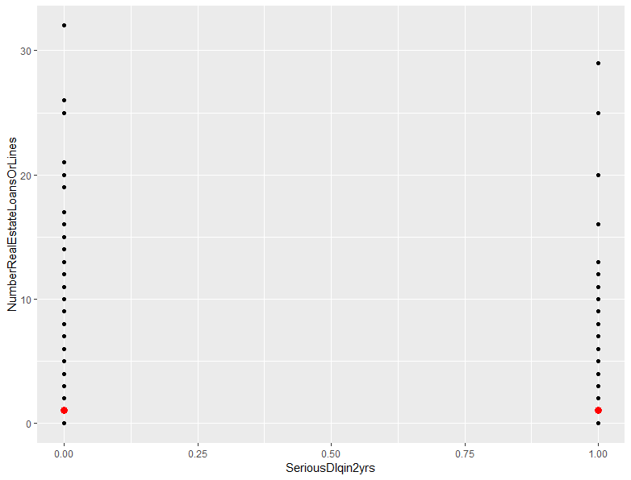
Data Normalization :
Noise reduction :
Hence, classification problems which contain noise are complex problems, accurate solutions are often difficult to achieve. The presence of noise in the data may affect the intrinsic characteristics of a classification problem, as these corruptions could introduce new properties in the problem domain.
In this case I eliminated outlier recorded to the separated Database named Noise

Slide 7
Data Normalization :
age
Min. : 21.00
1st Qu.: 41.00
Median : 51.00
Mean : 51.41
3rd Qu.: 61.00
Max. :102.00
RevolvingUtilizationOfUnsecuredLines
Min. :0.00000
1st Qu.:0.03676
Median :0.17780
Mean :0.33001
3rd Qu.:0.56619
Max. :2.98453
NumberOfTime30.59DaysPastDueNotWorse
Min. : 0.0000
1st Qu.: 0.0000
Median : 0.0000
Mean : 0.2931
3rd Qu.: 0.0000
Max. :98.0000
DebtRatio
Min. :0.000026
1st Qu.:0.149207
Median :0.293992
Mean :0.346992
3rd Qu.:0.467168
Max. :1.998765
MonthlyIncome
Min. :1.602
1st Qu.:3.556
Median :3.742
Mean :3.733
3rd Qu.:3.921
Max. :6.478
NumberOfOpenCreditLinesAndLoans
Min. : 0.000
1st Qu.: 5.000
Median : 8.000
Mean : 8.906
3rd Qu.:12.000
Max. :57.000
NumberOfTimes90DaysLate
Min. : 0.0000
1st Qu.: 0.0000
Median : 0.0000
Mean : 0.1181
3rd Qu.: 0.0000
Max. :98.0000
NumberRealEstateLoansOrLines
Min. : 0.000
1st Qu.: 0.000
Median : 1.000
Mean : 1.072
3rd Qu.: 2.000
Max. :32.000
NumberOfTime60.89DaysPastDueNotWorse
Min. : 0.00000
1st Qu.: 0.00000
Median : 0.00000
Mean : 0.09573
3rd Qu.: 0.00000
Max. :98.00000
NumberOfDependents
Min. : 0.0000
1st Qu.: 0.0000
Median : 0.0000
Mean : 0.8615
3rd Qu.: 2.0000
Max. :20.0000

Slide 8
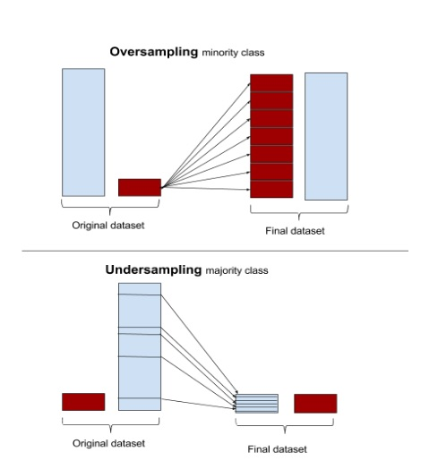
Data Balancing
"Balancing the data" in data mining is similar to the concept of weighting the data in traditional statistics, but there are a number of important differences.
Population
1 0
0.93079482 0.06920518
Accuracy
Accuracy : 0.772797

Slide 9
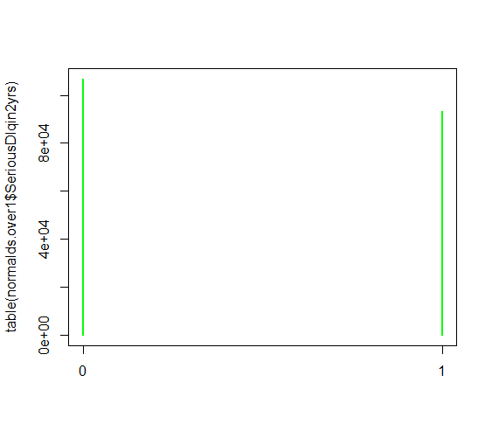
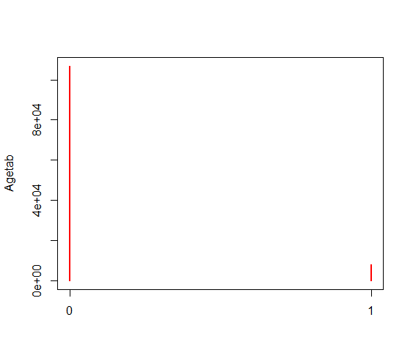
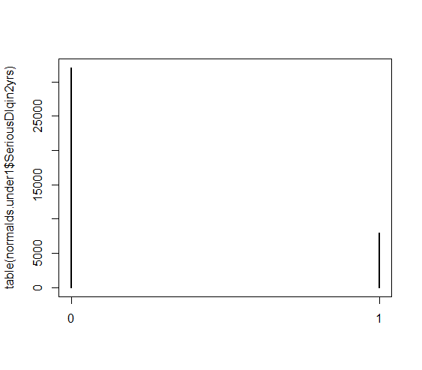
Under sampling VS Over Sampling
Over Sampling
Confusion matrix:
0 1 class.error
0 103603 3192 2.988904e-02
1 4 93201 4.291615e-05
Accuracy : 0.9816131
Under Sampling
Confusion matrix:
0 1 class.error
0 30332 1719 0.05363327
1 4316 3633 0.54296138

Slide 10
Test data preparation
All steps which have been done for the Train data, needs to be done on the test data as well.
In this step we are going to use the generated model against the unlabelled dataset or stream vectors to predict the appropriated class label
ts= read.csv('cs-test.csv’) # create dataset name TS as test data
tslabl=read.csv('sampleEntry.csv’) # probability dataset
Prediction :
Nomats$SeriousDlqin2yrs <- predict(mod, ts, type="response")
prop.table(table(ts$SeriousDlqin2yrs))
0 1
0.91809471 0.08190529
0 1
1 predicted from test data 0.919 0.0812
2 calculated from train dataset 0.931 0.0693

Slide 11


Future work:
In this project I omitted all NA values to reduce the complexity of model.
To deal with NA we can replace the NA with:
zero , mead, average, most frequent , or predict the possible value using linear regression. In future work I will complete the model using multi linear regression to predict the missing values and compare with this results.

Slide 12

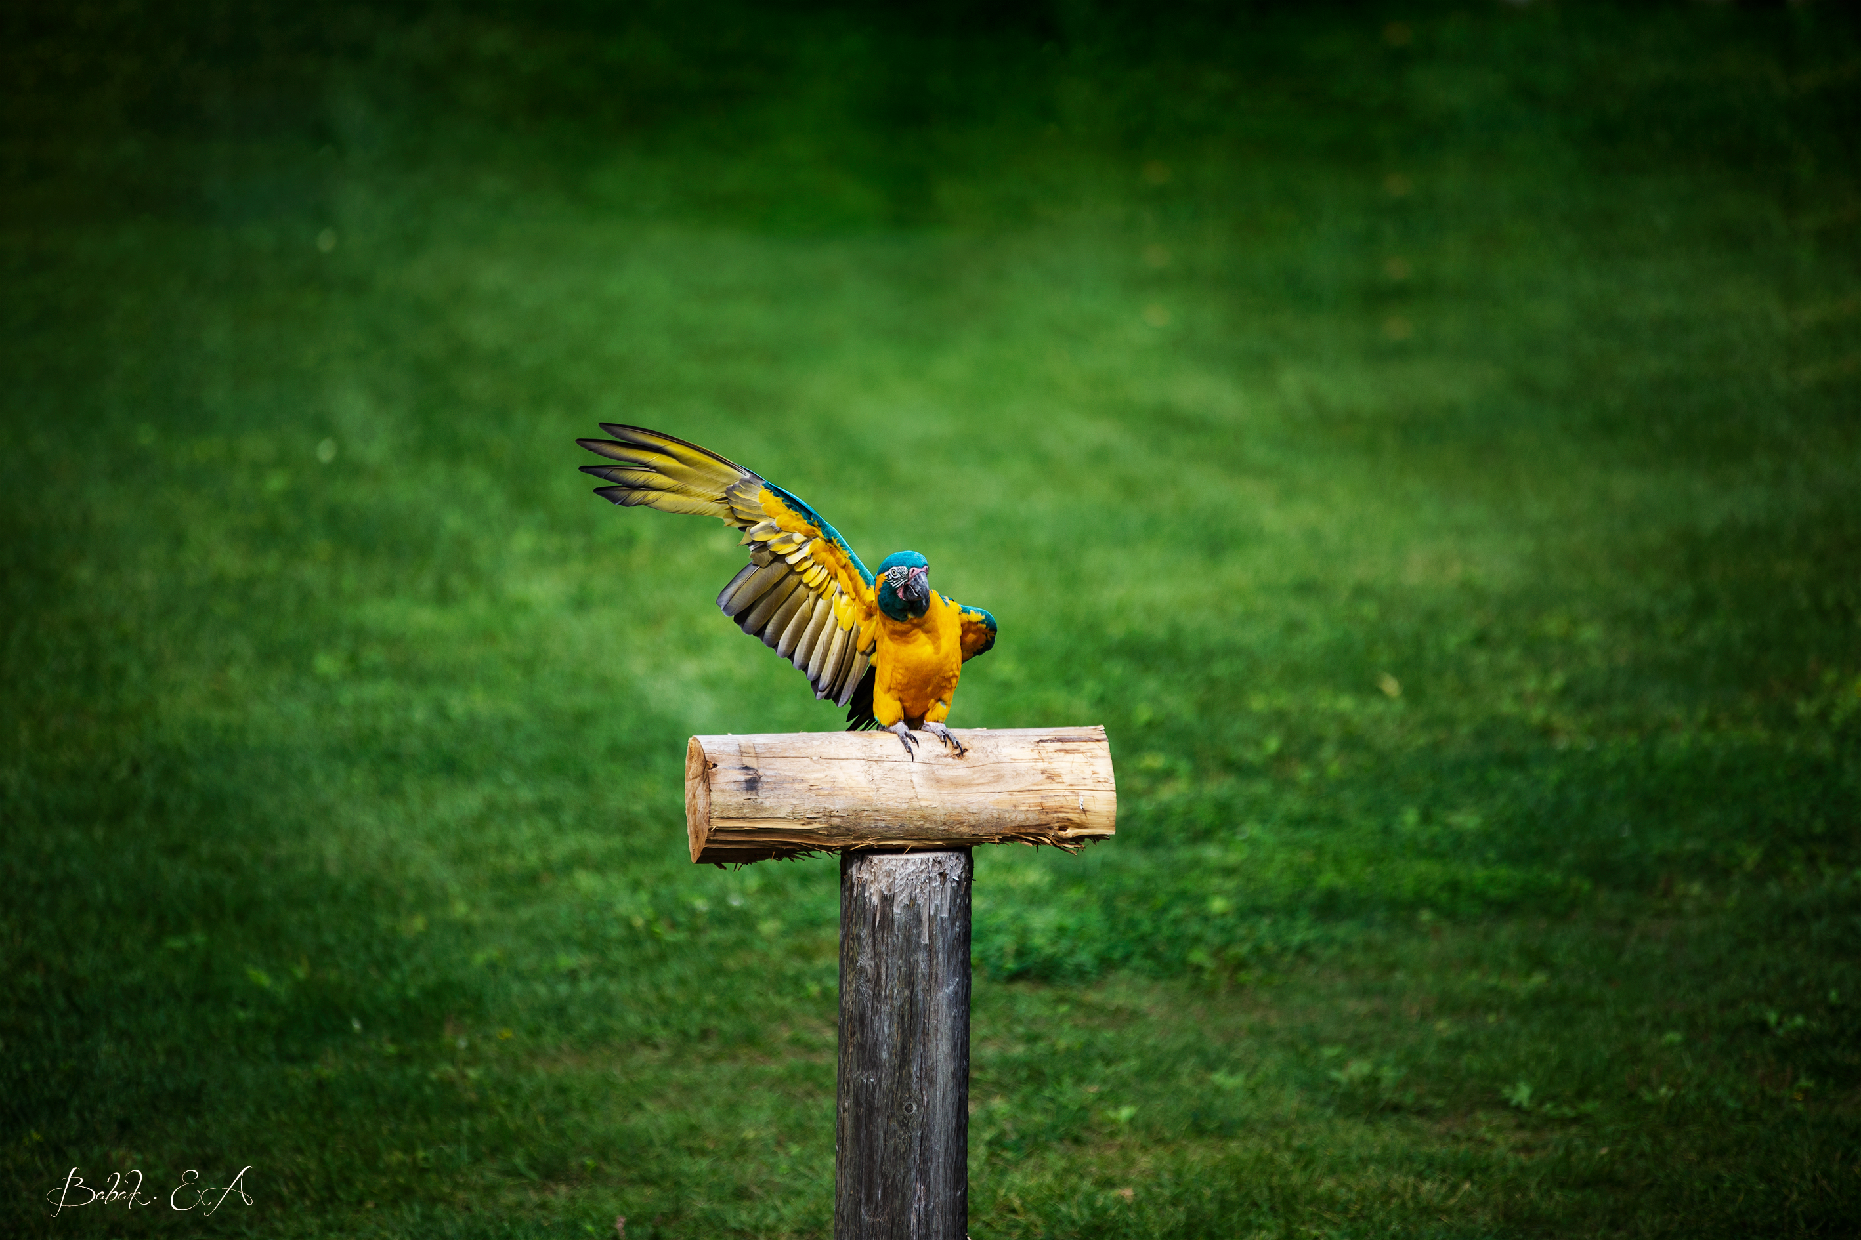
Thank you for the attention

